Slide 1
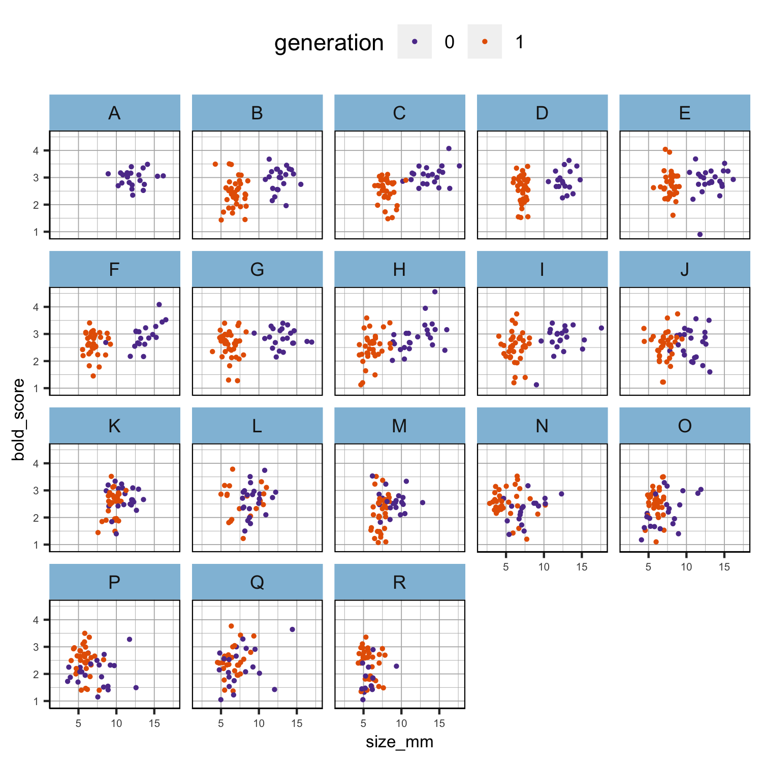
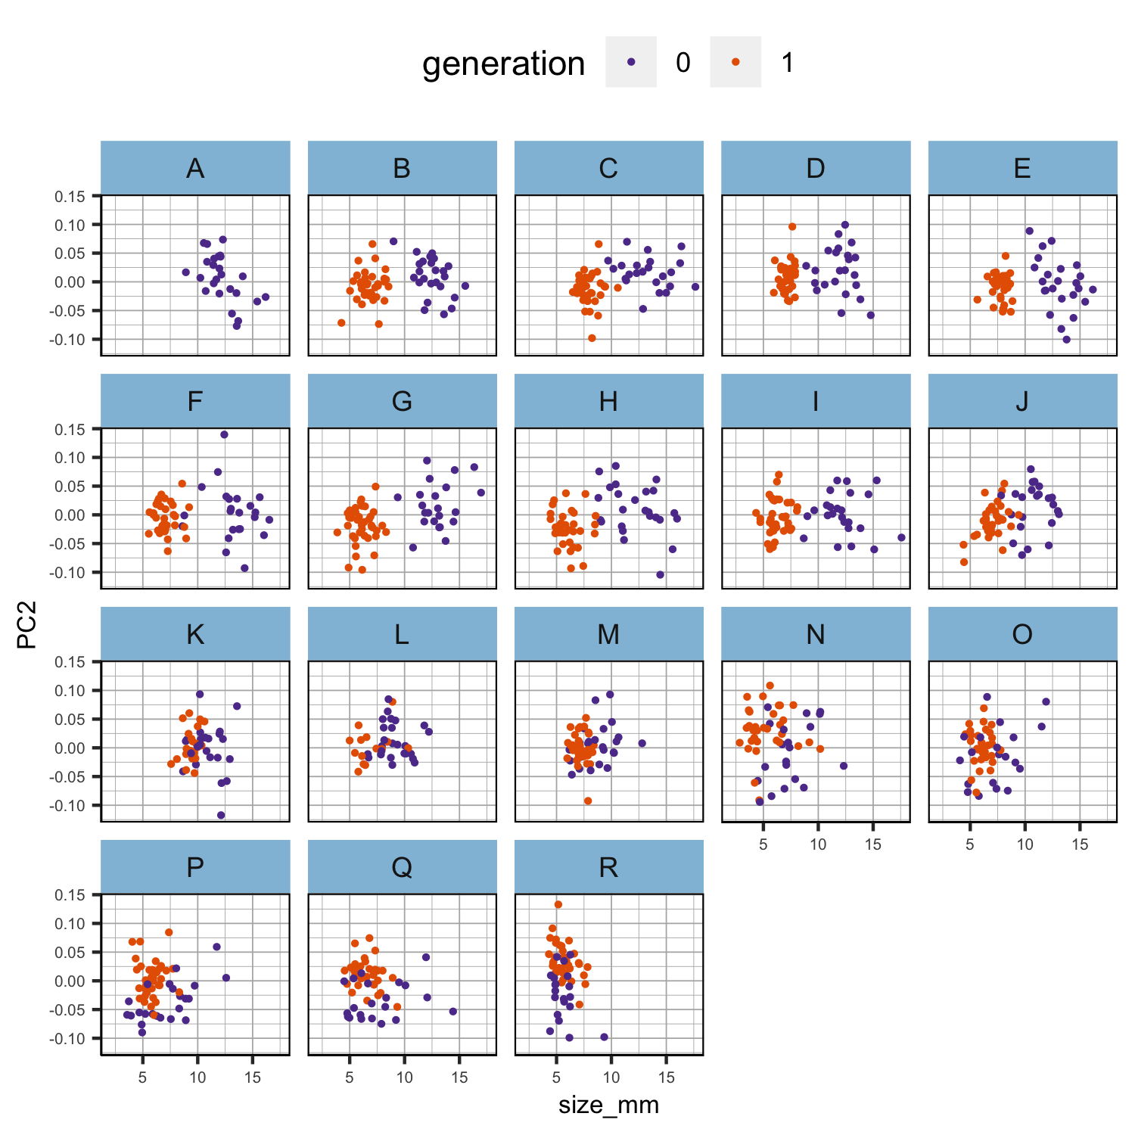
bold and PC2 seem to be size-independent
Figure 1ab. Scatter plots of the relationship between size and the other phenotypes per population in each generation separately. Phenotypic values have not been scaled.

Slide 2
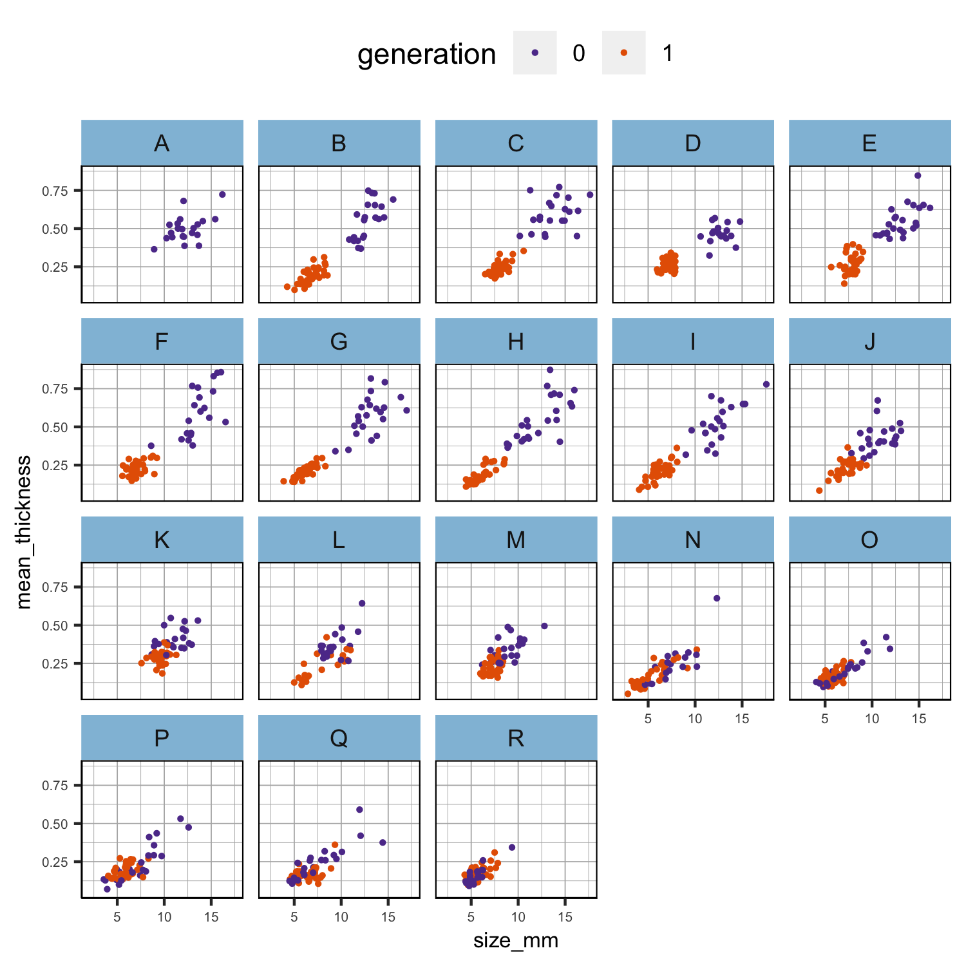
thickness is clearly size-dependent. There is some scatter, which might mean that there is some interesting size-independent thickness variation but it might also just mean that the thickness measurements are noisy!
Figure 1c. Scatter plots of the relationship between size and the other phenotypes per population in each generation separately. Phenotypic values have not been scaled.

Slide 3
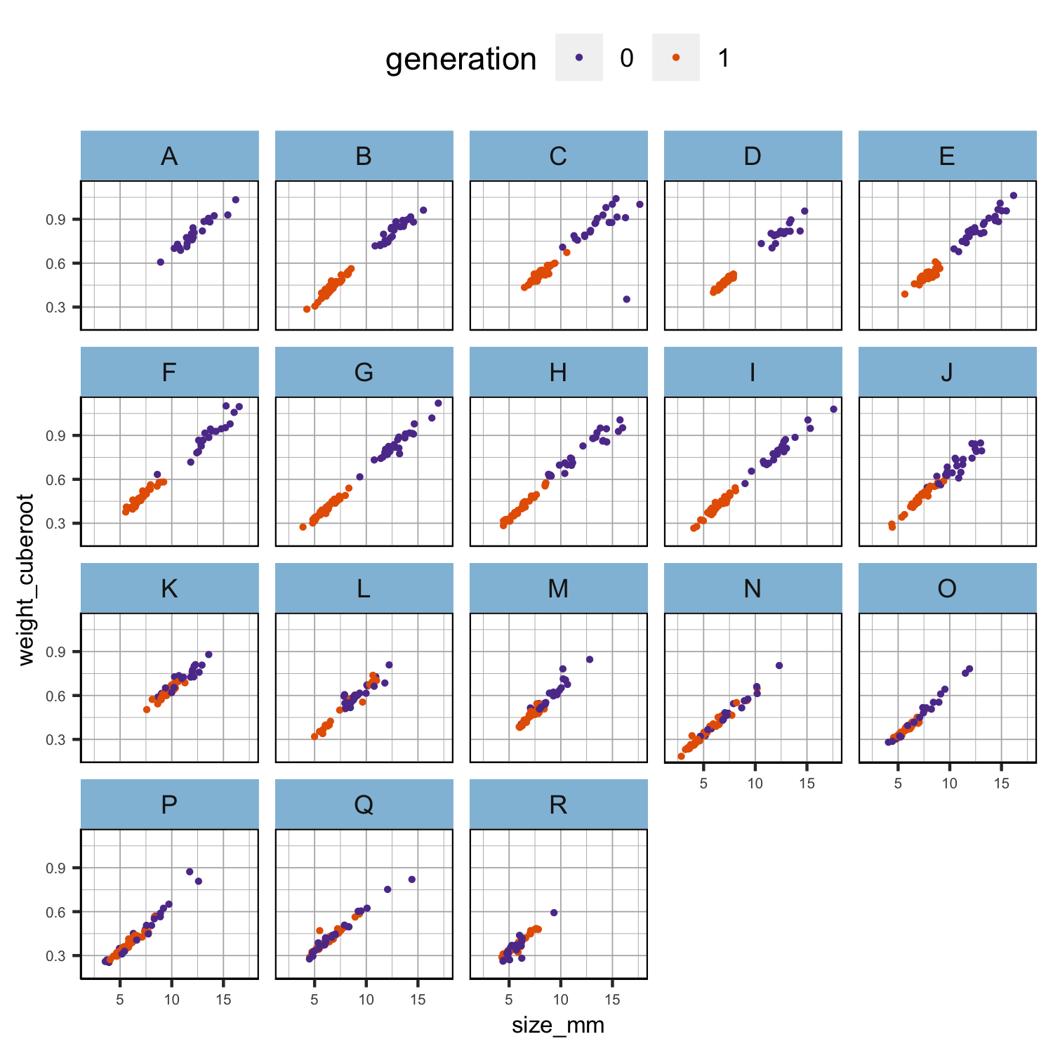
cube_root_weight looks almost perfectly correlated with size! Also, the relationship looks linear across the whole size range and very similar in all populations. It may be that there is no size-independent variation in weight.
Figure 1d. Scatter plots of the relationship between size and the other phenotypes per population in each generation separately. Phenotypic values have not been scaled.

Slide 4
WEIGHT
Gen0 is the expected pattern. Gen1 is flat. This is a bit odd.
There are two obvious alternative explanations (not mutually exclusive): sampling was timed for when the size reached a certain point, or size is very plastic. We might separate these effects (partly) by correcting for sampling time (although larger snails were taken at each time point, I guess). Ultimately, this sampling time issue might make it hard to say anything about plasticity for size (or weight).
Figure 2. Boxplot of the scaled cube root of weight per generation and population. Phenotypic values have been scaled.

Slide 5
WEIGHT
Gen0 is the expected pattern. Gen1 is flat. This is a bit odd.
There are two obvious alternative explanations (not mutually exclusive): sampling was timed for when the size reached a certain point, or size is very plastic. We might separate these effects (partly) by correcting for sampling time (although larger snails were taken at each time point, I guess). Ultimately, this sampling time issue might make it hard to say anything about plasticity for size (or weight).
Figure 2. Boxplot of the scaled cube root of weight per generation and population. Phenotypic values have been scaled.
The lack of effect of sampling time on weight suggests that larger individuals were chosen on each occasion. I think this means that we really cannot say anything useful about plasticity for size. It is better to concentrate on (a) using size to adjust weight and thickness, and (b) trying to analyze size at maturity.
Figure tmp2. Boxplot of the scaled cube root of weight per generation and population. Generation 1 was further divided into two groups (2 in orange was sampled in June and 3 in green was sampled in August; group x in violet is for unknown samples and contains only six individuals). Phenotypic values have been scaled.

Slide 6
WEIGHT
Table 1a. AIC of the models fitted to the observed data of generation 0 parents after scaling.
Formula | AIC
weight ~ size | -228.53
weight ~ size + maturity | -241.47
weight ~ size x maturity | -243.26
weight ~ size + population | -249.62
weight ~ size x maturity x population | -256.74
weight ~ size + maturity + population | -264.43
weight ~ size x population | -267.51
Figure 3a. Best model fit to the observed data of generation 0 parents after scaling.

Slide 7
WEIGHT
Table 1b. AIC of the models fitted to the observed data of generation 1 offspring after scaling.
Formula | AIC
weight ~ size x maturity | -1149.83
weight ~ size + maturity | -1151.78
weight ~ size | -1152.26
weight ~ size x maturity x population | -1179.71
weight ~ size + population | -1207.49
weight ~ size + maturity + population | -1211.52
weight ~ size x population | -1216.25
Figure 3b. Best model fit to the observed data of generation 1 offspring after scaling.

Slide 8
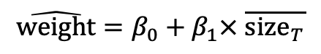
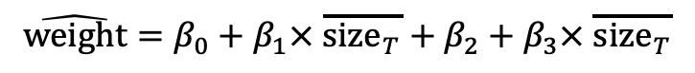
WEIGHT
Weights were adjusted to the overall mean size using the regression for each tank.
Adjusted weight for population B generation 1 offspring (there is no population A) was
$$\hat{\text{weight}}=β_{0}+β_{1}\text{×} \overline{{\text{size}}_{T}}$$
Where $\overline{{\text{size}}_{T}}$ is the overall mean snail size of the experiment after scaling.
And for population C generation 1 offspring was
$$\hat{\text{weight}}=β_{0}+β_{1}× \overline{{\text{size}}_{T}}+β_{2}+β_{3}\text{×} \overline{{\text{size}}_{T}}$$
where $β_{2}$ is the offset from $β_{0}$ for population C and $β_{3}$ is the regression coefficient for the interaction between population C and the overall mean size.

Slide 9
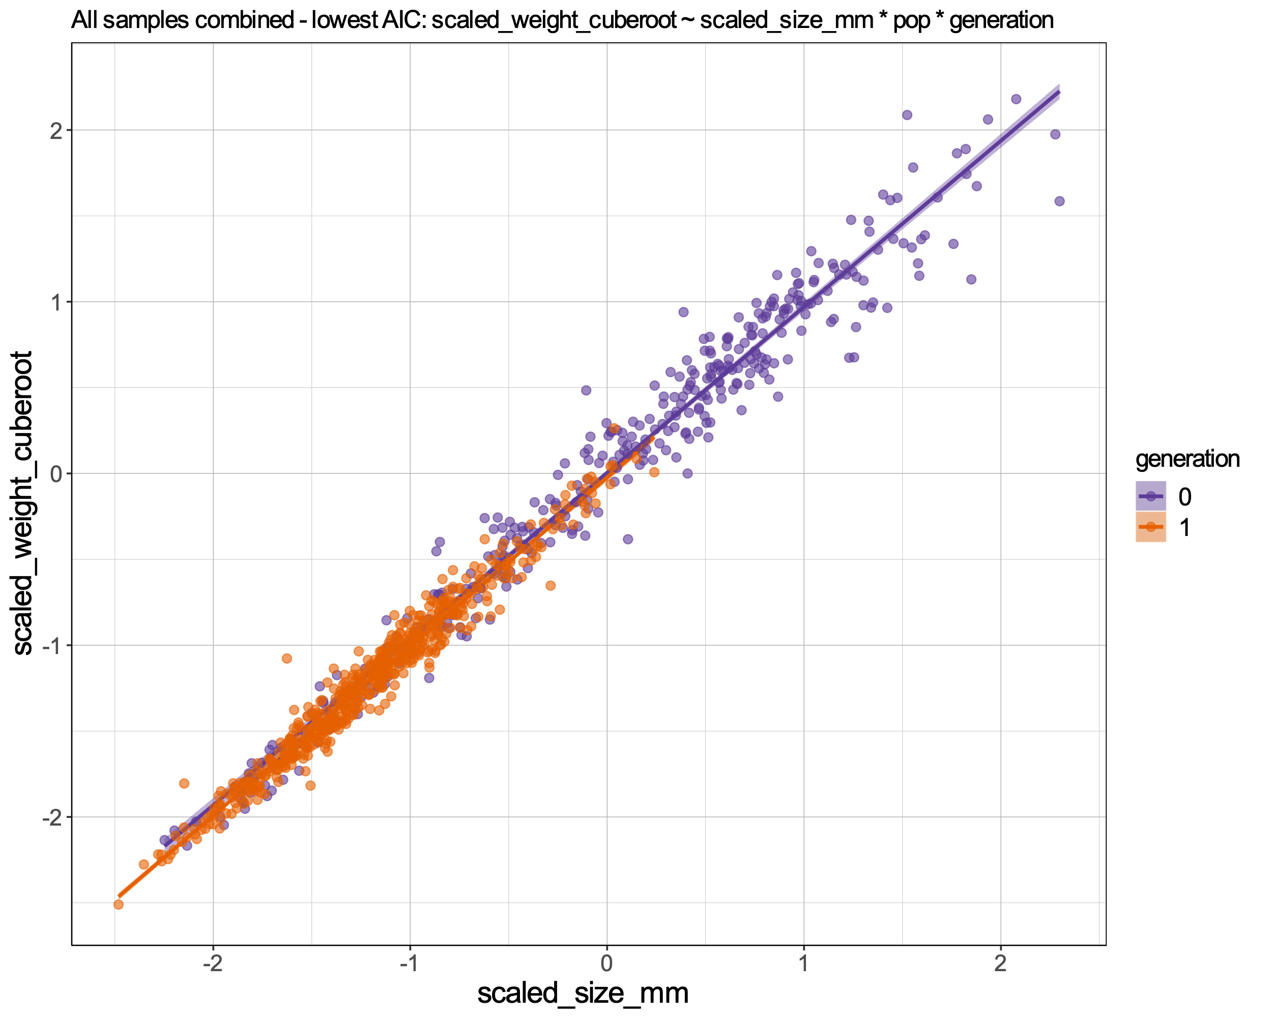
WEIGHT
However, where slopes differ, it is not really appropriate just to adjust all weights to the overall mean but, given that slope variation is not very great, we used these adjusted values (Fig. 4) for the phenotypic analysis and also compared the slopes between gen0 and gen1, effectively as another trait (Fig. 3c).
Table 1c. AIC of the models fitted to the observed data with all samples combined after scaling.
Formula | AIC
weight ~ size x population x generation | -1304.886
weight ~ size x population | -1231.196
weight ~ size x generation | -1178.288
Figure 3c. Best model fit to the observed data with all samples combined after scaling. Showing only the generation effect.

Slide 10
WEIGHT
Predict what the mean $\ln{\text{weight}}$ for snails in each tank would be at the overall mean size of snails (after scaling = -0.74) for the experiment (with associated standard error).
Figure 2. Boxplot of the scaled cube root of weight per generation and population. Phenotypic values have been scaled.
Figure 4. Predicted phenotype and 95% CIs for each population using the best model fit and the overall mean size of snails for the experiment.

Slide 11
WEIGHT
Predict what the mean $\ln{\text{weight}}$ for snails in each tank would be at the overall mean size of snails (after scaling = -0.74) for the experiment (with associated standard error).
gen0 does still show a weak weight cline (and maybe there is even a hint of a cline in gen1 - so incomplete plasticity). At first sight, this is inconsistent with the analyses in slides 6 and 7. However, 'population' in those analyses had a lot of degrees of freedom (16 or 17?). This makes it hard to get a significant effect (i.e. it lacks power). What we see here is a clinal effect on population means (4 degrees of freedom at most - centre, width and end means).
Despite the strong and apparently invariant relationship between size and weight, it really looks like there is weight variation across the cline. I wonder how much of that is explained by thickness.
Figure 4. Predicted phenotype and 95% CIs for each population using the best model fit and the overall mean size of snails for the experiment.

Slide 12
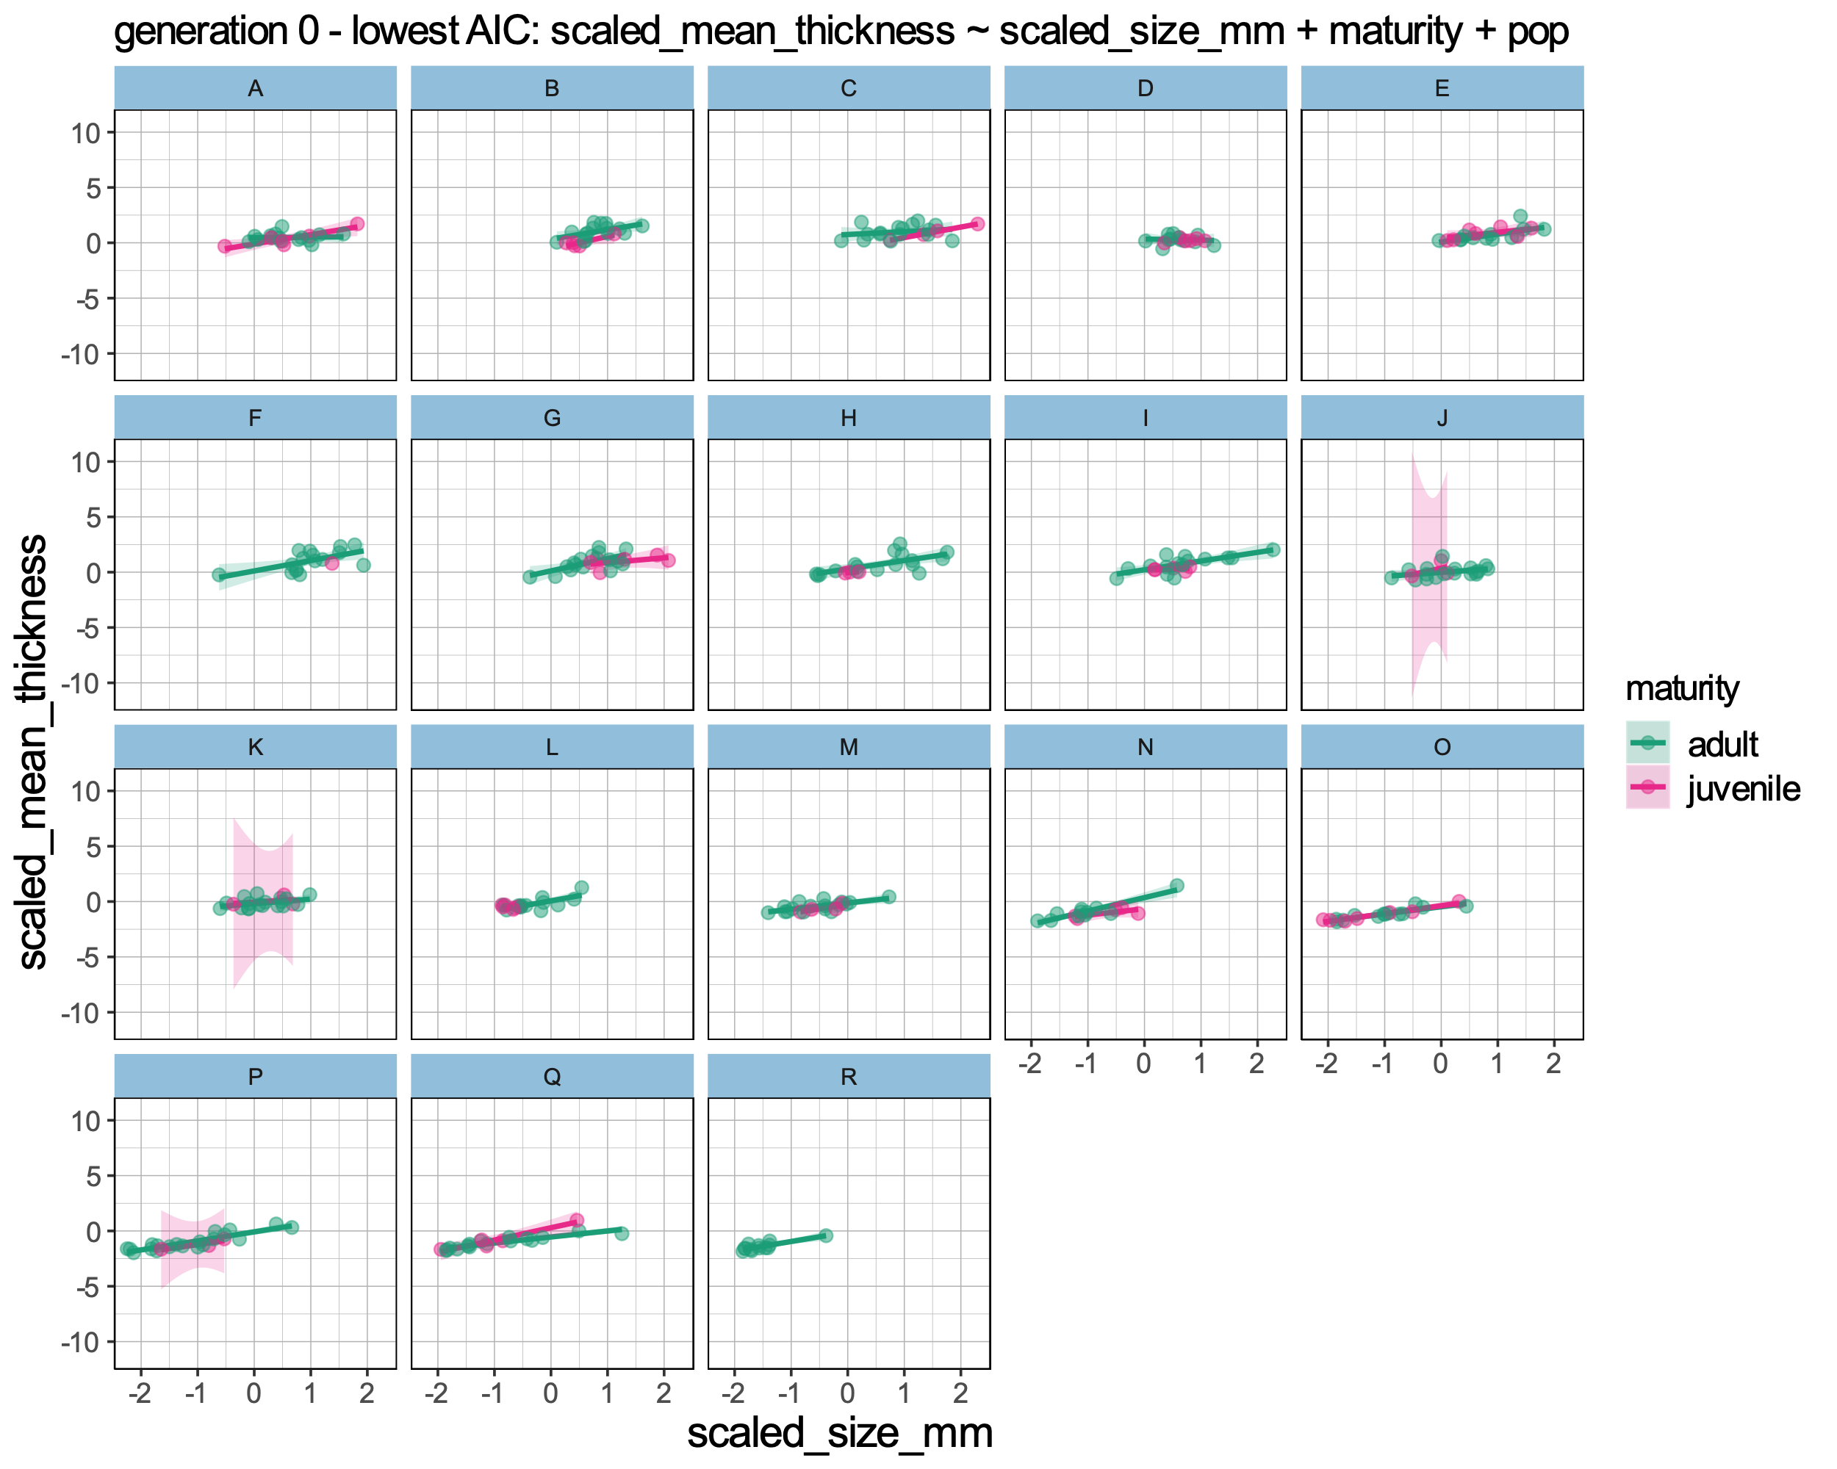
THICKNESS
Table 2a. AIC of the models fitted to the observed data of generation 0 parents after scaling.
Formula | AIC
thick ~ size + maturity + pop | 481.42
thick ~ size + pop | 486.21
thick ~ size * pop | 496.14
thick ~ size + maturity | 499.30
thick ~ size * maturity | 499.76
thick ~ size | 504.13
thick ~ size * maturity * pop | 509.96
Figure 5a. Best model fit to the observed data of generation 0 parents after scaling.

Slide 13
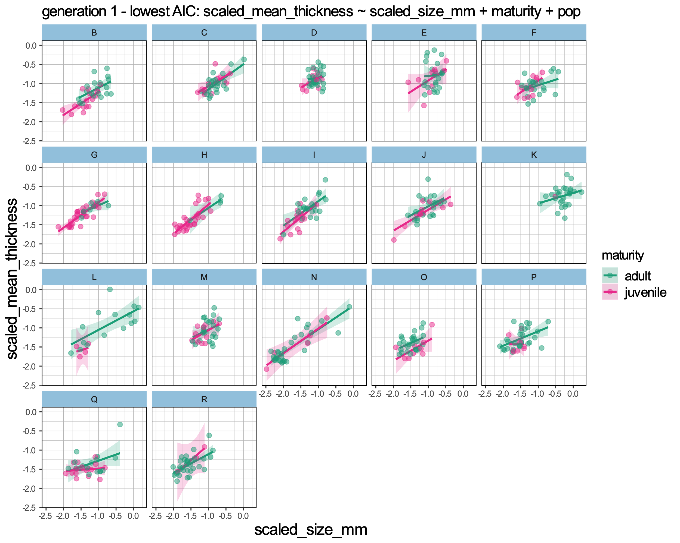
THICKNESS
Table 2b. AIC of the models fitted to the observed data of generation 1 offspring after scaling.
Formula | AIC
thick ~ size + maturity + pop | -57.53
thick ~ size + pop | -52.83
thick ~ size * pop | -45.47
thick ~ size * maturity * pop | -9.91
thick ~ size * maturity | 26.10
thick ~ size + maturity | 27.40
thick ~ size | 28.06
Figure 5b. Best model fit to the observed data of generation 1 parents after scaling.

Slide 14
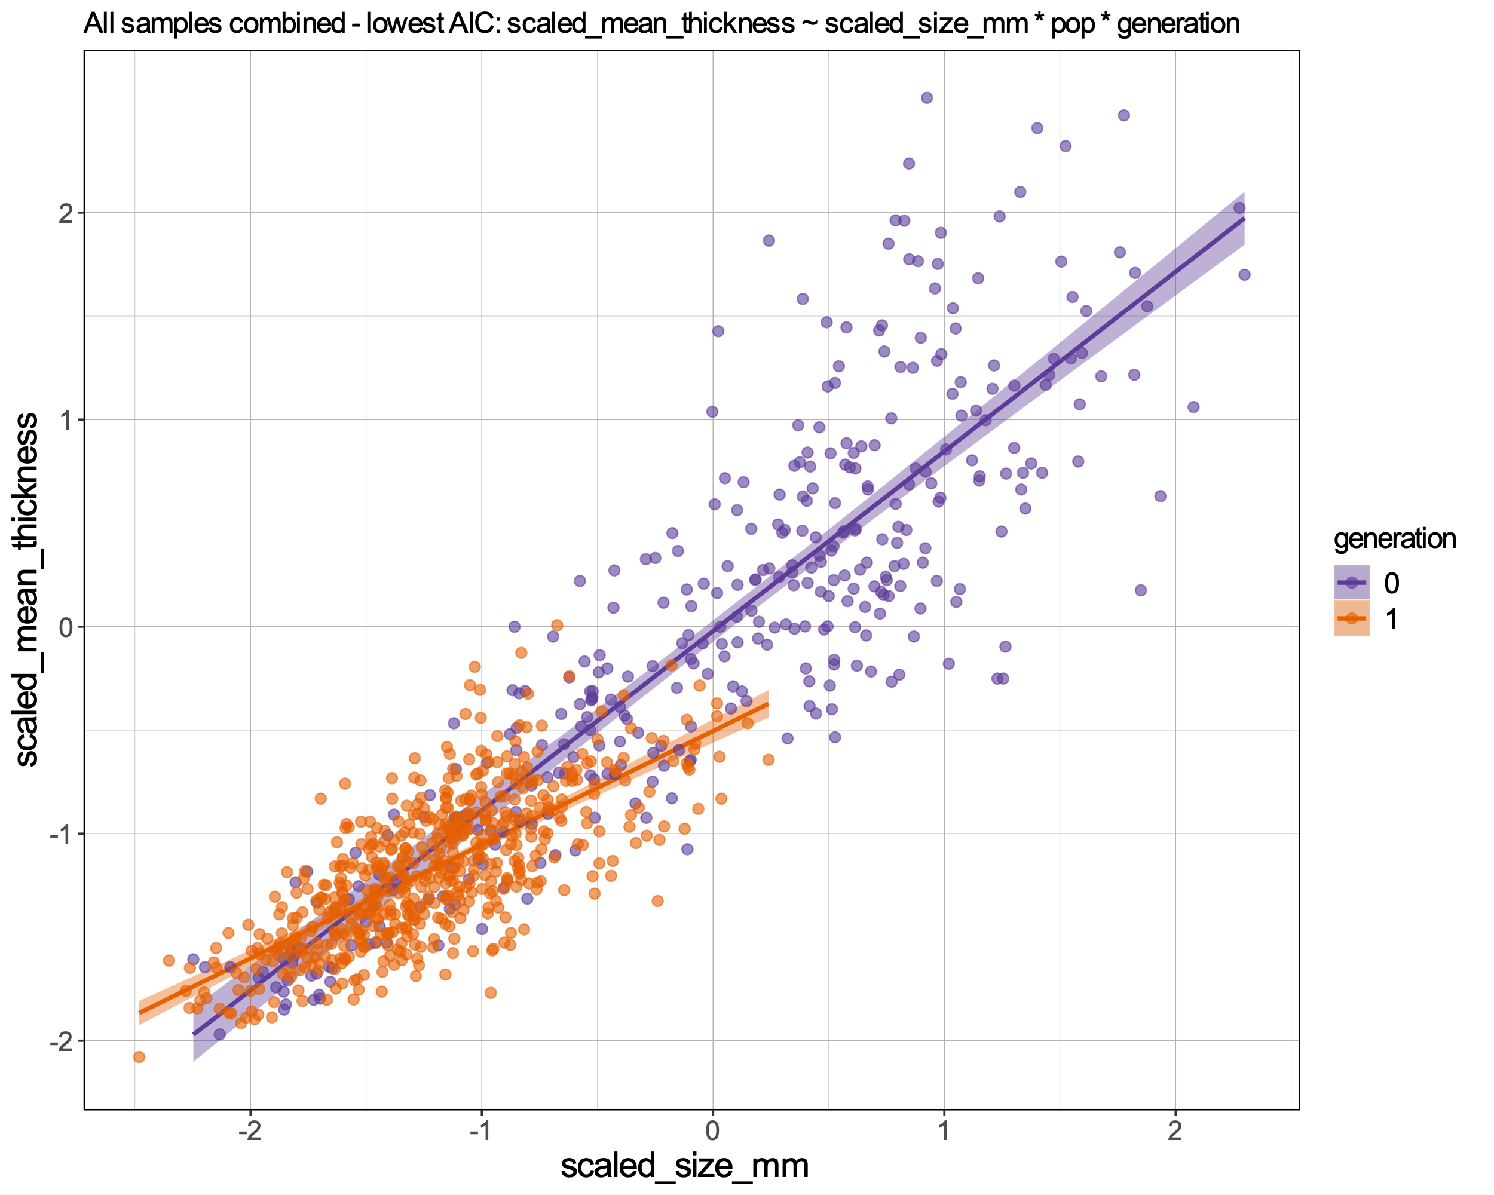
THICKNESS
Comparison between slopes of generation 0 and generation 1.
Table 2c. AIC of the models fitted to the observed data with all samples combined after scaling.
Formula | AIC
thick ~ size x population x generation | 669.1503
thick ~ size x generation | 743.4834
thick ~ size x population | 754.1876
Figure 5c. Best model fit to the observed data with all samples combined after scaling. Showing only the generation effect.

Slide 15
If weight variation that is not accounted for by size is mainly caused by variation in thickness, then the results for weight and thickness should be very similar after size effects have been removed. You could look at this with simple correlations of the adjusted means (Fig. 6a-b) and regression coefficients (Table 3a-b).

Slide 16
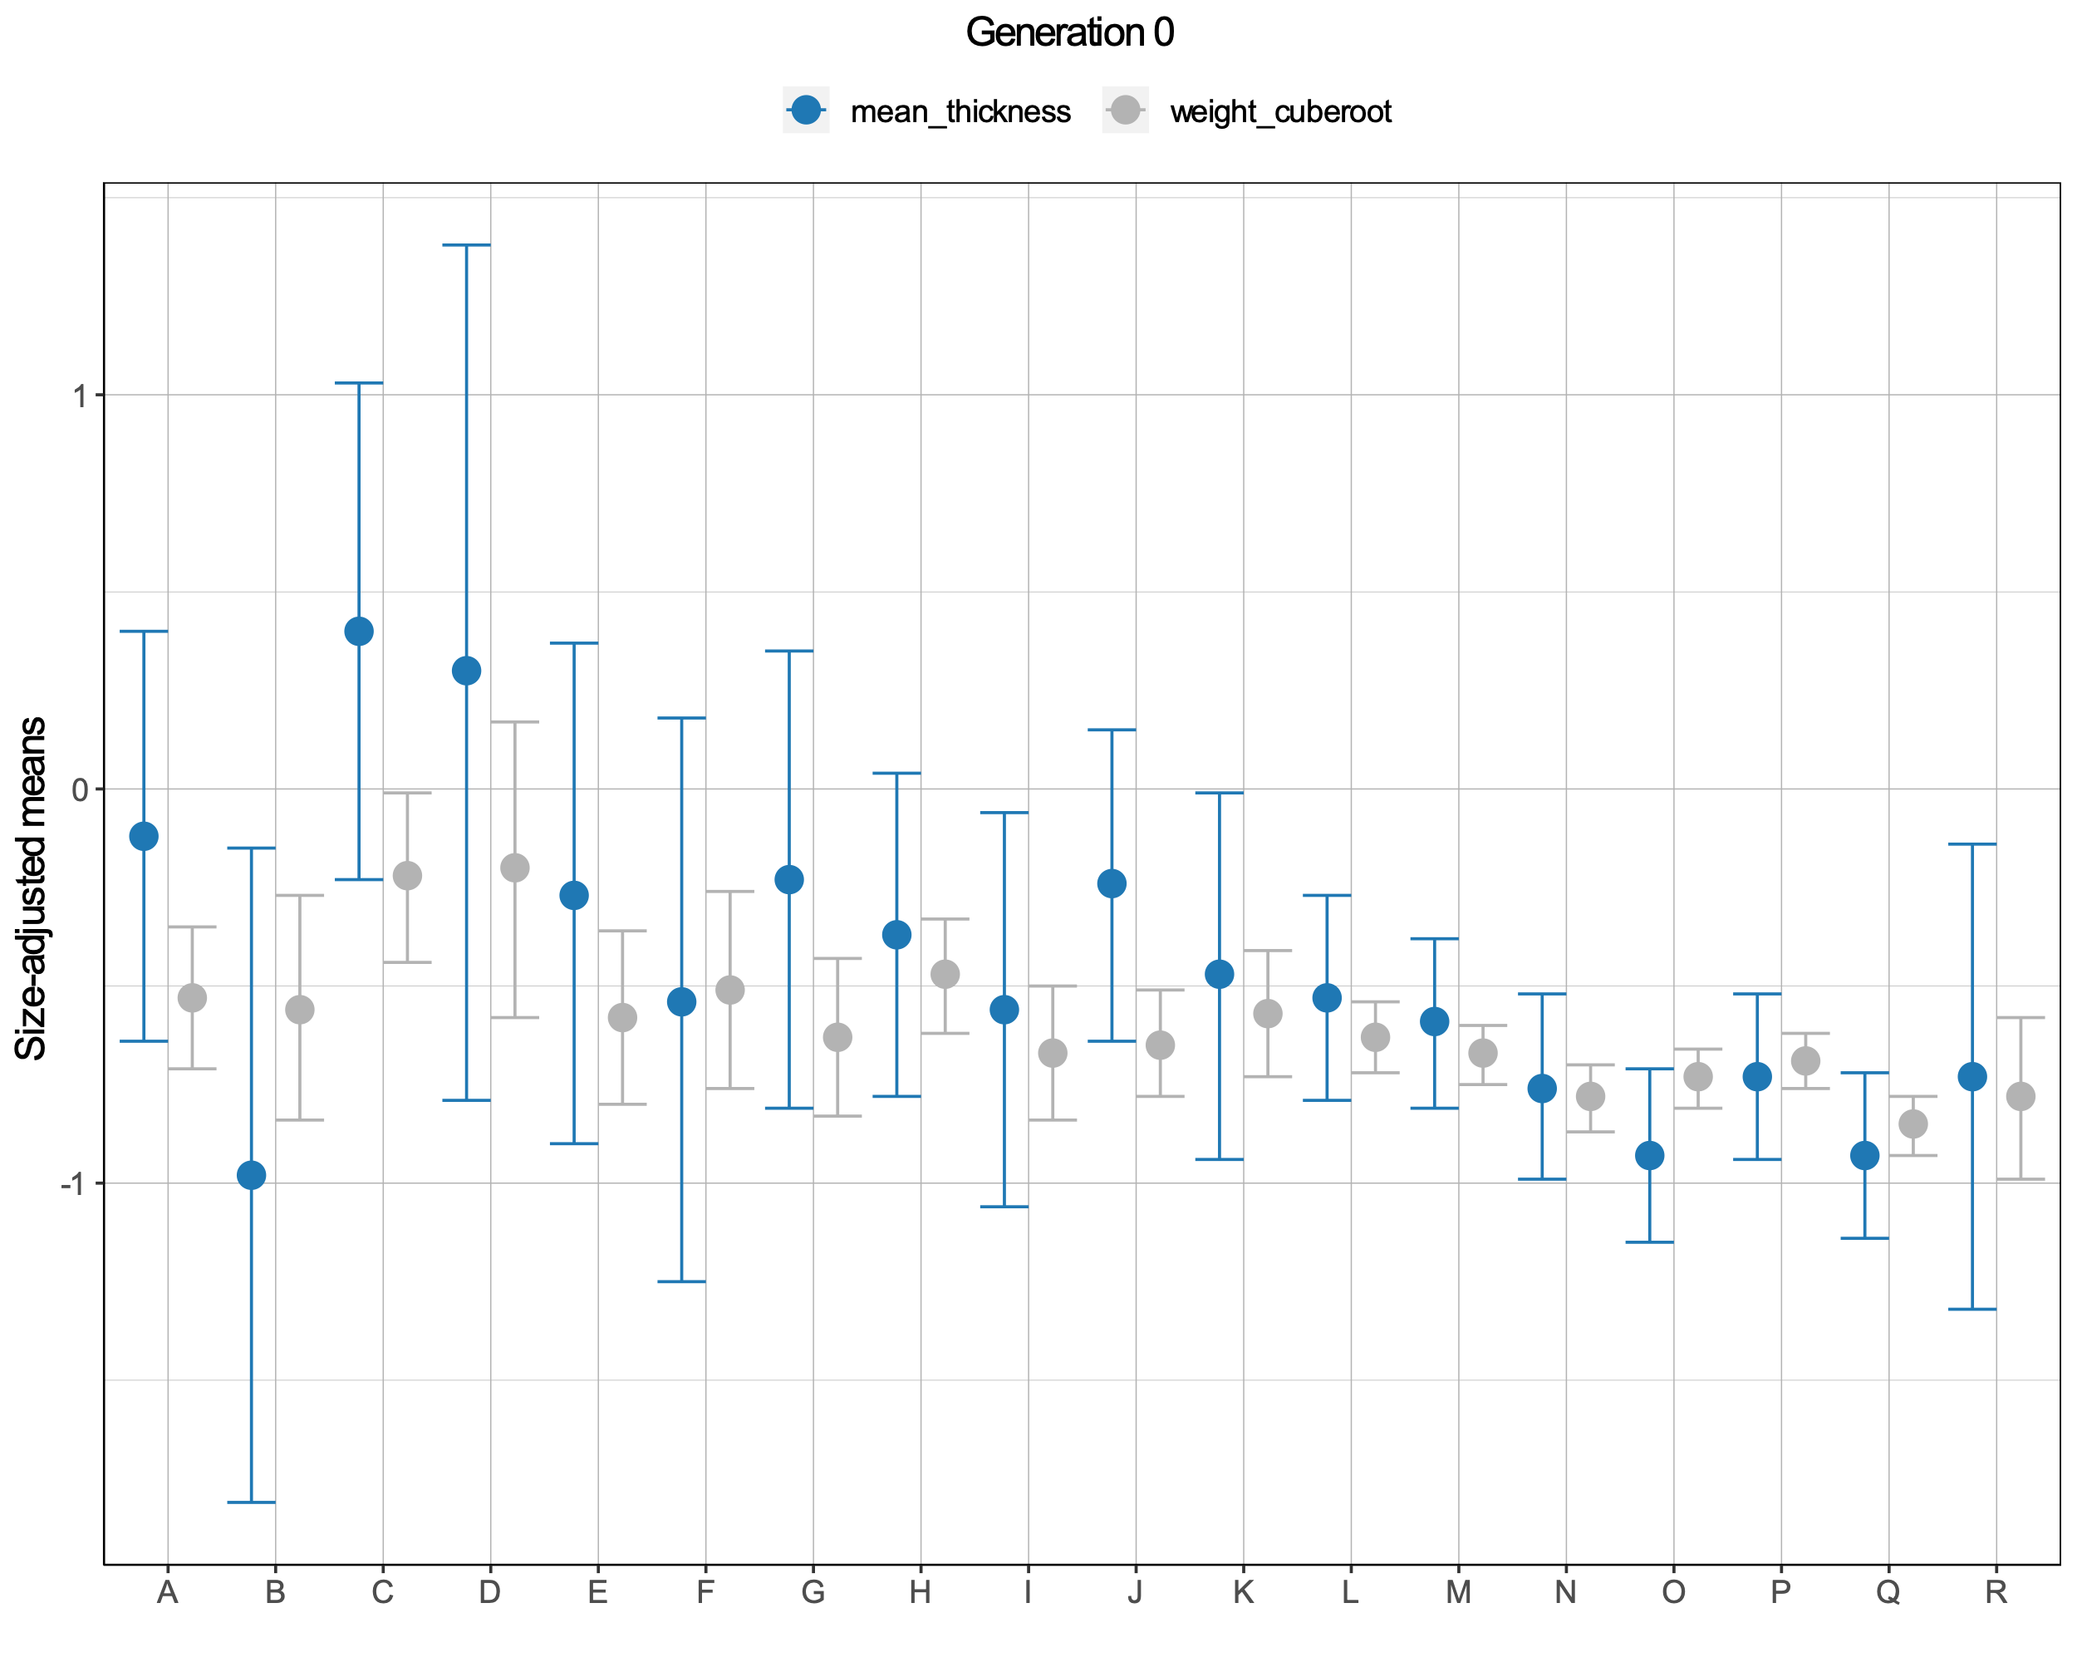
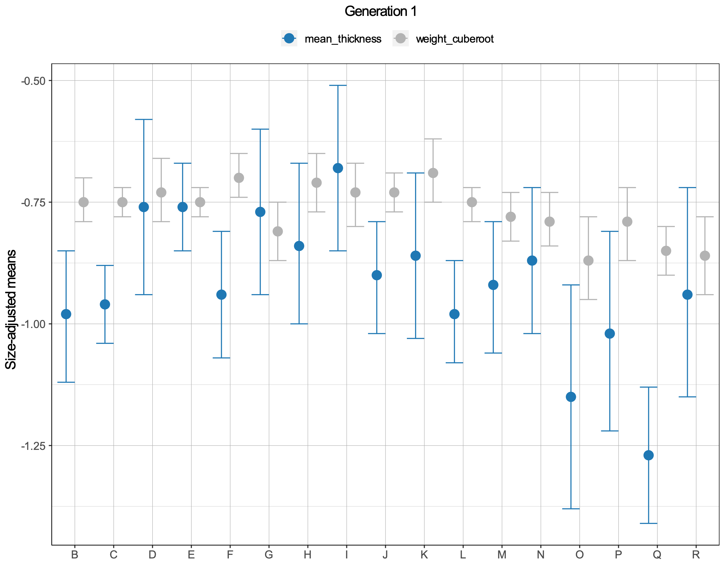
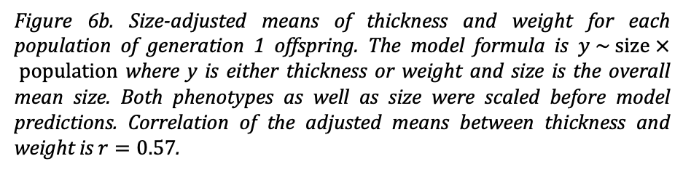
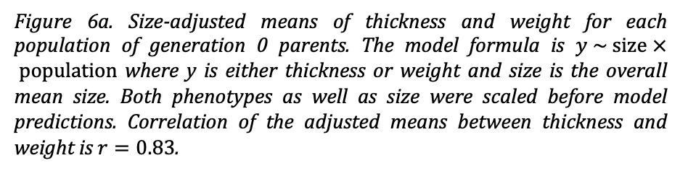
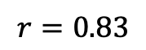
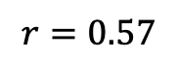
WEIGHT and THICKNESS: Correlation of the adjusted means
$$r=0.83$$
$$r=0.57$$
Figure 6a. Size-adjusted means of thickness and weight for each population of generation 0 parents. The model formula is $y \sim \text{size} × \text{population}$ where y is either thickness or weight and size is the overall mean size. Both phenotypes as well as size were scaled before model predictions. Correlation of the adjusted means between thickness and weight is $r=0.83$.
Figure 6b. Size-adjusted means of thickness and weight for each population of generation 1 offspring. The model formula is $y \sim \text{size} × \text{population}$ where y is either thickness or weight and size is the overall mean size. Both phenotypes as well as size were scaled before model predictions. Correlation of the adjusted means between thickness and weight is $r=0.57$.

Slide 17
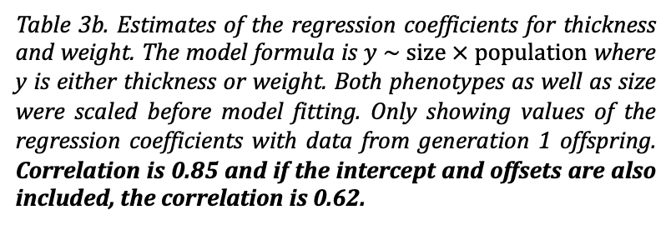
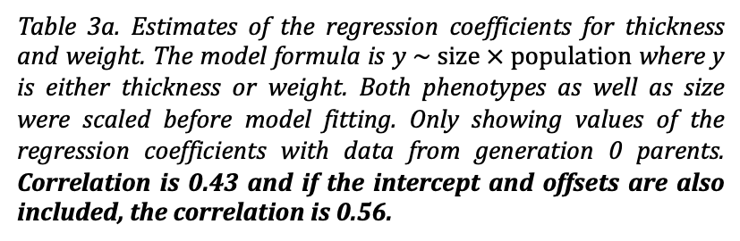
WEIGHT and THICKNESS: Correlation of the regression coefficients
Table 3a. Estimates of the regression coefficients for thickness and weight. The model formula is $y \sim \text{size} × \text{population}$ where y is either thickness or weight. Both phenotypes as well as size were scaled before model fitting. Only showing values of the regression coefficients with data from generation 0 parents. Correlation is 0.43 and if the intercept and offsets are also included, the correlation is 0.56.
Table 3b. Estimates of the regression coefficients for thickness and weight. The model formula is $y \sim \text{size} × \text{population}$ where y is either thickness or weight. Both phenotypes as well as size were scaled before model fitting. Only showing values of the regression coefficients with data from generation 1 offspring. Correlation is 0.85 and if the intercept and offsets are also included, the correlation is 0.62.
Parameter | Thickness | Weight
size | 0.44 | 0.87
size:B | 0.74 | -0.02
size:C | -0.12 | -0.21
size:D | -0.46 | -0.29
size:E | 0.20 | 0.04
size:F | 0.45 | 0.07
size:G | 0.27 | 0.06
size:H | 0.36 | -0.07
size:I | 0.39 | 0.05
size:J | -0.08 | 0.02
size:K | -0.03 | -0.06
size:L | 0.36 | -0.08
size:M | 0.13 | 0.15
size:N | 0.54 | 0.05
size:O | 0.23 | 0.16
size:P | 0.36 | 0.17
size:Q | 0.10 | 0.00
size:R | 0.41 | 0.06
Parameter | Thickness | Weight
size | 0.64 | 1.00
size:C | -0.04 | -0.14
size:D | -0.30 | -0.09
size:E | -0.22 | -0.21
size:F | -0.30 | -0.07
size:G | -0.01 | -0.07
size:H | 0.05 | 0.02
size:I | 0.13 | -0.02
size:J | -0.09 | -0.01
size:K | -0.37 | -0.14
size:L | -0.06 | 0.05
size:M | -0.15 | -0.10
size:N | -0.01 | -0.06
size:O | -0.25 | -0.10
size:P | -0.26 | -0.06
size:Q | -0.36 | -0.14
size:R | -0.11 | -0.11

Slide 18
One option would be to fit a model a bit like the one we discussed for size at maturity, in this case having a constant slope but allowing the intercept to vary clinally. However, it might be better to stick with a simpler option. Just use the size-adjusted weights you have plotted in slide 8 and take them through to the plasticity analysis.
The input data are the vectors x (size-adjusted means of generation 0 parents), sd_x (standard deviation calculated as $\text{SD}\text{ = }\text{SE} × \sqrt{n}$ where $\text{SE}$ is the standard error for the predicted means and $n$ is the number of parental individuals in each population) and y (size-adjusted means of generation 1 offspring). The length of the vectors is N = 17.
data {
int<lower=0> N;
vector[N] x;
vector[N] y;
vector<lower=0>[N] sd_x;
}
The parameters accepted by the model are the vector x_lat of length N and the real numbers alpha, beta and sigma. Finally, the parameter mu_yhat is a vector with a linear relationship with x_lat also of length N.
Priors are defined for x_lat, alpha, beta and sigma. We model x to be normally distributed with mean x_lat and standard deviation sd_x. We also model y to be normally distributed with mean mu_hat and standard deviation sigma.
parameters {
vector[N] x_lat;
real alpha;
real beta;
real<lower=0> sigma;
}
transformed parameters {
vector[N] mu_yhat = alpha + beta * x_lat;
}
model {
x_lat ~ normal(0, 10);
alpha ~ normal(0, 10);
beta ~ normal(1, 10);
sigma ~ cauchy(0, 2);
x ~ normal(x_lat, sd_x);
y ~ normal(mu_yhat, sigma);
}

Slide 19
WEIGHT: Plasticity analysis
Input data
Table 4. Weight input data for the plasticity analysis. After scaling, cube root weights were size-adjusted for each population (Pop) in generation 0 parents (x) and in generation 1 offspring (y) separately. Standard deviations (sd_x and sd_y) were calculated as $\text{SD}=\text{SE} × \sqrt{n}$. Stan input data are highlighted in orange.
x | SE | n | Pop | Gen | sd_x
-0.56 | 0.15 | 20 | B | 0 | 0.65
-0.22 | 0.11 | 20 | C | 0 | 0.49
-0.20 | 0.19 | 17 | D | 0 | 0.78
-0.58 | 0.11 | 20 | E | 0 | 0.50
-0.51 | 0.13 | 17 | F | 0 | 0.52
-0.63 | 0.10 | 22 | G | 0 | 0.48
-0.48 | 0.07 | 21 | H | 0 | 0.31
-0.66 | 0.08 | 20 | I | 0 | 0.38
-0.65 | 0.07 | 21 | J | 0 | 0.32
-0.57 | 0.08 | 21 | K | 0 | 0.38
-0.63 | 0.05 | 19 | L | 0 | 0.20
-0.67 | 0.04 | 21 | M | 0 | 0.17
-0.79 | 0.04 | 16 | N | 0 | 0.17
-0.73 | 0.04 | 20 | O | 0 | 0.17
-0.69 | 0.04 | 23 | P | 0 | 0.17
-0.85 | 0.04 | 21 | Q | 0 | 0.17
-0.78 | 0.10 | 13 | R | 0 | 0.37
y | SE | n | Pop | Gen | sd_y
-0.75 | 0.02 | 35 | B | 1 | 0.14
-0.75 | 0.01 | 35 | C | 1 | 0.09
-0.73 | 0.03 | 36 | D | 1 | 0.20
-0.75 | 0.02 | 33 | E | 1 | 0.09
-0.70 | 0.02 | 33 | F | 1 | 0.14
-0.81 | 0.03 | 39 | G | 1 | 0.20
-0.71 | 0.03 | 34 | H | 1 | 0.18
-0.73 | 0.03 | 37 | I | 1 | 0.19
-0.73 | 0.02 | 35 | J | 1 | 0.12
-0.69 | 0.03 | 29 | K | 1 | 0.17
-0.75 | 0.02 | 19 | L | 1 | 0.08
-0.78 | 0.02 | 35 | M | 1 | 0.15
-0.79 | 0.03 | 36 | N | 1 | 0.17
-0.87 | 0.04 | 35 | O | 1 | 0.25
-0.80 | 0.04 | 37 | P | 1 | 0.23
-0.85 | 0.03 | 33 | Q | 1 | 0.15
-0.86 | 0.04 | 36 | R | 1 | 0.24

Slide 20
WEIGHT: Plasticity analysis
Parameters
Inference for Stan model. 4 chains, each with iteration = 12000; warmup = 4000; thin = 1; post-warmup draws per chain = 8000, total post-warmup draws = 32000.
Parameter | Mean | SD | 2.5% | 50% | 97.5% | n_eff | R_hat
alpha | -0.702 | 0.038 | -0.778 | -0.701 | -0.631 | 2002 | 1.002
beta | 0.117 | 0.062 | -0.010 | 0.122 | 0.226 | 1561 | 1.003
sigma | 0.038 | 0.018 | 0.005 | 0.038 | 0.075 | 936 | 1.004
Figure 7. Posterior distributions of the parameters and diagnostics. Parameters x_lat and mu_yhat are not shown. Sampling problems are highlighted in red.

Slide 21
WEIGHT: Plasticity analysis
Warning messages
1: There were 501 divergent transitions after warmup. Increasing adapt_delta above 0.99 may help. See
http://mc-stan.org/misc/warnings.html#divergent-transitions-after-warmup
2: There were 4 chains where the estimated Bayesian Fraction of Missing Information was low. See
http://mc-stan.org/misc/warnings.html#bfmi-low
4: Tail Effective Samples Size (ESS) is too low, indicating posterior variances and tail quantiles may be unreliable.
Running the chains for more iterations may help. See
http://mc-stan.org/misc/warnings.html#tail-ess

